Slide 1
Custom Processors for Cryptocurrency Mining
Benjamin Davis

Slide 2

Overview
What is CryptoCurrency?
The Block Chain
Mining
What hardware is needed?
CPUs, GPUs
Optimizations
ASICs
Statistics
Conclusion

Slide 3
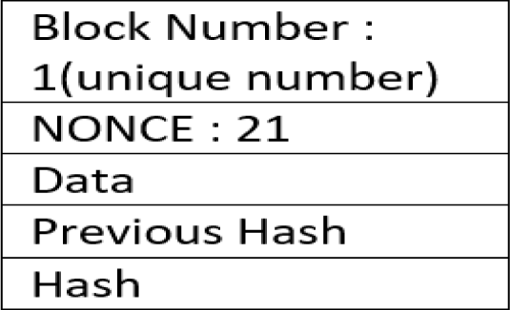
What is the Blockchain?
The blockchain is basically the collection of transactions associated with a particular bitcoin.
The main one is the Proof-of-Work (PoW) Consensus protocol
All the nodes in the network participate in the authentication
The NONCE is a (Number used only once)
[1] A. Kaushik, A. Choudhary, C. Ektare, D. Thomas and S. Akram, "Blockchain-Literature Survey", 2nd IEEE International Conference On Recent Trends in Electronics Information & Communication Technology (RTEICT), 2017.

Slide 4
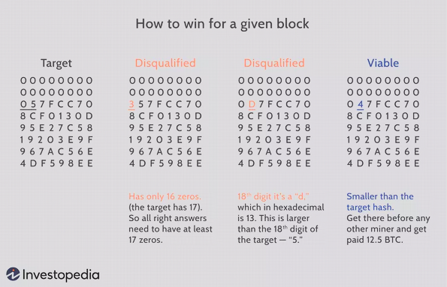
Mining
Mining takes a series of hashes on blocks using the SHA-256 hashing concept
It increments the NONCE and tries to find a hash lower than the previous one in hex
Along the way it authenticates other bitcoin transactions through the blocks
[2] E. Hong, “How does bitcoin mining work?,” Investopedia, https://www.investopedia.com/tech/how-does-bitcoin-mining-work/#citation-23 (accessed Apr. 21, 2024).

Slide 5
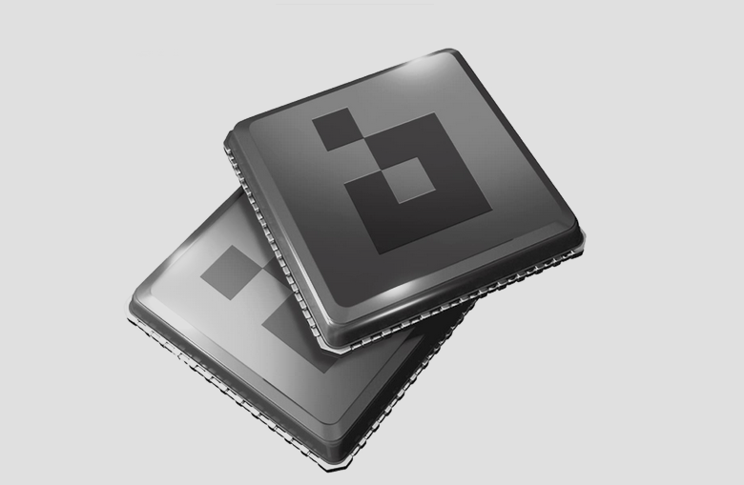
What hardware is needed?
Mining is a very computationally intense process to produce hashes over and over again.
The Mining Systems use GPUs (Graphical Processing Units) or they use custom CPUs
The custom CPUs are called ASICs (Application Specific Integrated Circuit)
[3] “ASIC Сhip,” Bitfury, https://bitfury.com/hardware/asic-old (accessed Apr. 21, 2024).

Slide 6
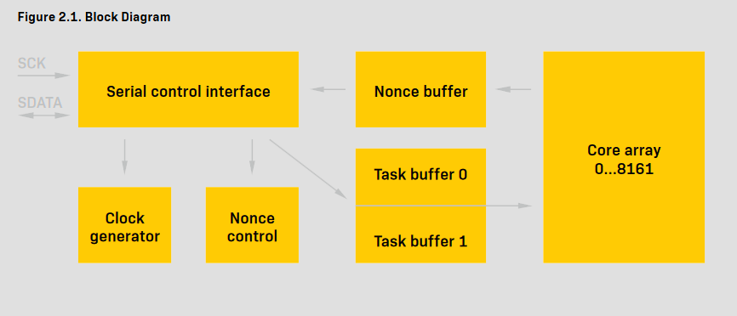
Optimizations Basics
ASICs are set up specifically to run cryptocurrency algorithm and verify the block chain.
The BITFURY BF8162B had its datasheet published for use
[4] “16-nm-asic-datasheet-2018-04-003.” BITFURY, 456 Montgomery St., Suite 1350, San Francisco, CA 94104, United States, 2018
Notes:
SCK = Serial clock input; SDATA = Serial Data input/output; Serial control interface block does all communications with external controller via serial bu

Slide 7
Optimizations Specifics
The Serial Control Interface handles external communication
Nonce Control handles calculation control
The Task Buffers queue needed information of instructions like the mask
The Nonce buffer contains Nonces and task switch markers
[4] “16-nm-asic-datasheet-2018-04-003.” BITFURY, 456 Montgomery St., Suite 1350, San Francisco, CA 94104, United States, 2018
Notes:
SCK = Serial clock input; SDATA = Serial Data input/output; Task Buffers 20 Dwords (Next task, SHA calculations) , Nonce buffer is 12 Dwords, Core array is 8162 array of SHA-256 kernels

Slide 8
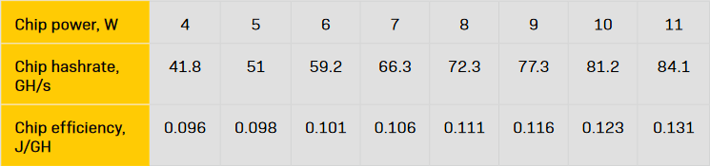
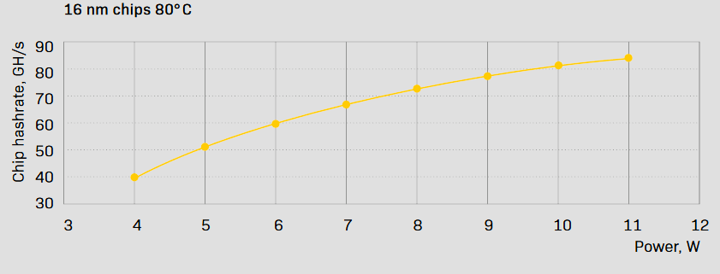
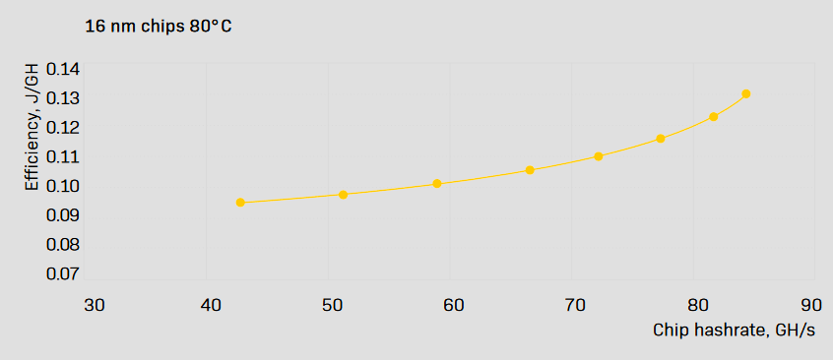
Statistics
[4] “16-nm-asic-datasheet-2018-04-003.” BITFURY, 456 Montgomery St., Suite 1350, San Francisco, CA 94104, United States, 2018

Slide 9
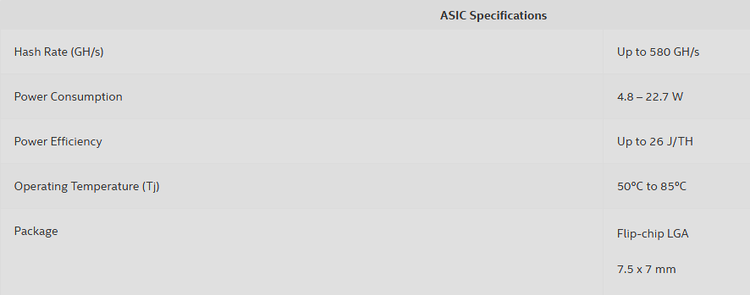
Statistics
Intel Blockscale 1120, 1140, 1160 (ran from June 2022 - April 2023)
GH/s - Gigahash/Second
J/TH - Joules/Terahash
This is contrasted with other processors being measured in the KH/s or Kilohash/Second. Meaning there are 9 orders of magnitude between an ordinary CPU and a Crypto mining one
[5] Pdf, “Intel® blockscaleTM ASIC,” Intel, https://www.intel.com/content/www/us/en/products/docs/blockchain/custom-asic-product-brief.html (accessed Apr. 21, 2024).

Slide 10
Conclusion
Regular CPUs were originally used for crypto mining and quickly migrated to GPUs which have a better throughput which helps when doing hashes in the millions
However, due to concerns with power consumption and a desire to see better hash times the ASIC CPUs started being produced in order to keep a competitive edge on other miners.
Many of the CPUs we have been discussing in class are a general purpose case.
The overall architecture of the ASIC chips is quite different
This embodies the idea of “make the common case fast” (specific computation, not worried about other operations)

Slide 11
Bibliography
[1] A. Kaushik, A. Choudhary, C. Ektare, D. Thomas and S. Akram, "Blockchain-Literature Survey", 2nd IEEE International Conference On Recent Trends in Electronics Information & Communication Technology (RTEICT), 2017.
[2] E. Hong, “How does bitcoin mining work?,” Investopedia, https://www.investopedia.com/tech/how-does-bitcoin-mining-work/#citation-23 (accessed Apr. 21, 2024).
[3] “ASIC Сhip,” Bitfury, https://bitfury.com/hardware/asic-old (accessed Apr. 21, 2024).
[4] “16-nm-asic-datasheet-2018-04-003.” BITFURY, 456 Montgomery St., Suite 1350, San Francisco, CA 94104, United States, 2018
[5] Pdf, “Intel® blockscaleTM ASIC,” Intel, https://www.intel.com/content/www/us/en/products/docs/blockchain/custom-asic-product-brief.html (accessed Apr. 21, 2024).

Slide 12
Questions?

